Slide 1


ROLL NO | PROJECT MEMBERS | E-MAIL ADDRESS
181421 | SAHIL SHARMA | 181421@juitsolan.in
181361 | KETAN MITTAL | 181361@juitsolan.in

Slide 2
HOME AUTOMATION SYTEM

Slide 3
ABSTRACT
Internet of things concept works with almost every machine. But when this is all about our home appliances, IoT proposes a smart, automated system. Using IoT based automation system users can control home stuff anywhere from the world.
In this project, we are talking about a touch-based home automation system based on microcontroller. It contains WIFI, inbuilt touch sensing input pins, which makes it helpful to make IoT based projects like this.

Slide 4
PROBLEM statement
Home automation is perhaps the most talked of IoT projects. IoT-based home automation project aims to automate the functioning of household appliances and objects over the Internet. All the household objects that are connected over the IoT network can be controlled and operated through your smart phone.
This is not only convenient but also gives more power to the user to control and manage household appliances from any location in the world.

Slide 5
LITERATURE SURVEY
A REVIEW PAPER ON HOME AUTOMATION
Published in - International Journal of Engineering and Techniques - Volume 4 Issue 1, Jan – Feb 2018
Author : Nikita Baidya , Prem Kumar S
Summary:
In this paper, we used a Wi-Fi wireless technology to monitor the device. An android application is installed in a mobile device i.e. android smart phone and it has inbuilt switch interface of all the appliances separately in it. Through which all the respective devices can be control and monitor individually. The Wi-Fi module receives the command from mobile phone and passes to relay circuit. As per the given signal from the user, the relay circuit switched ON/OFF the respective devices. The main purpose of using Wi-Fi wireless technology is to provide a greater extent to range and better feasibility.

Slide 6
LITERATURE SURVEY
Home Automation Using Internet of Things
Published in -International Research Journal of Engineering and Technology (IRJET)- Volume: 02 Issue: 03 | Jan-2015
Author : Vinay sagar K N, Kusuma S M
Summary :
In this paper we present a Home Automation system(HAS) using Intel Galileo that employs the integration of cloud networking, wireless communication, to provide the user with remote control of various lights, fans, and appliances within their home and storing the data in the cloud. The system will automatically change on the basis of sensors’ data. This system is designed to be low cost and expandable allowing a variety of devices to be controlled.

Slide 7
LITERATURE SURVEY
Home automation using IOT application
Published in – International Journal of Smart Home Vol.11, No.9(2017), p.p. 1-8
Author : Gaurav Panwar, Rajat Maurya, Rajesh Rawat, Rohit Kanswal and Praful Ranjan
Summary :
In the project we embedded the ESP8266 Wi-Fi module with sugar cube relays to control devices wirelessly or from particular distance. Here we use hotspot configurations, that to achieve our project goal, first of all we create a hotspot channel to connect other devices and so ESP8266 .Then when we configure the correct IP address which is generated by the software ‘Arduino.ide’ for the other devices to connect.

Slide 8
Hardware requirement
ESP8266 NodeMCU
USB Type C cable to program ESP8266 from a laptop or PC.
LED with Resistor (1K) – To test the touch
Breadboard – To place the components
Any metal plate to sense touch. You can even use Alluminium foil by connecting a wire to it.

Slide 9
ESP-8266 Nodemcu
In this project, we will add simple touch buttons to the ESP-8266 Wi-Fi module. ESP-8266 is a great module to design IoT applications and adding touch to it will make it further smart. Talking about ESP-8266, it is a micro-controller designed by Espressif mainly for IoT applications. It is so handy that even a novice can use it. ESP-8266 contains Wi-Fi, Bluetooth, Inbuilt Touch sensing input pins, temperature and hall sensors on board which makes it fit for IoT and Smart home.
In ESP-8266, there are total 10 Touch Sensing general purpose Input Output (GPIO) pins. A touch-sensor system is built on a substrate which carries electrodes and relevant connections under a protective flat surface. When a user touches the surface, the capacitance variation is triggered, and a binary signal is generated to indicate whether the touch is valid.

Slide 10
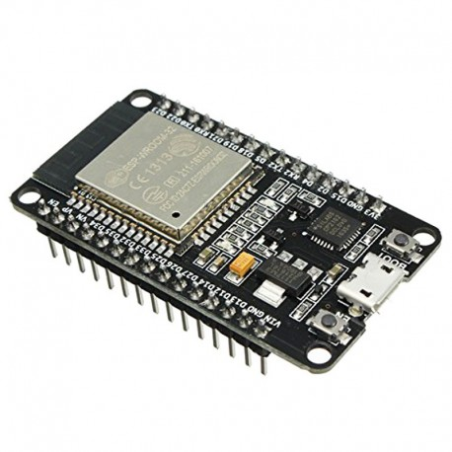
ESP-8266 Nodemcu
ESP8266 can provide up to 10 capacitive touch pads / GPIOs. The sensing pads can be arranged in different combinations (e.g. matrix, slider) so that a larger area or more points can be detected. The touchpad sensing process is under the control of a hardware-implemented finite-state machine (FSM) which is initiated by software or a dedicated hardware timer. We will learn how to handle these touch pins and try to make an IoT application around it. We will also integrate Wi-Fi control to it.

Slide 11
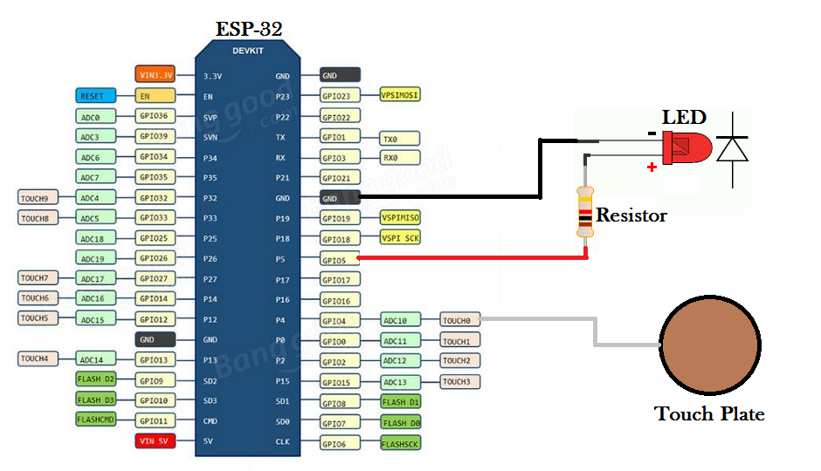
circuit diagram

Slide 12
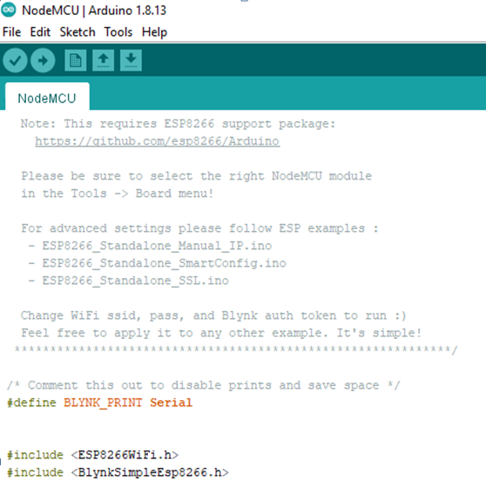
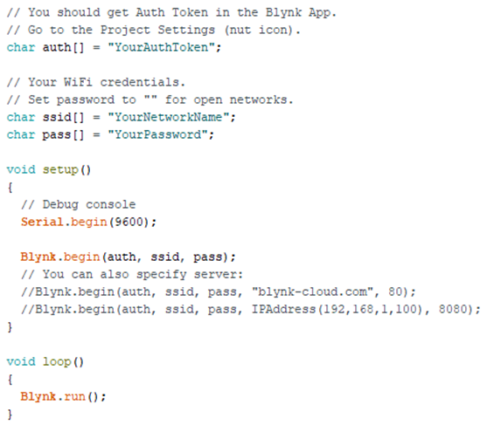
SNIPPET OF THE PSEUDO CODE

Slide 13
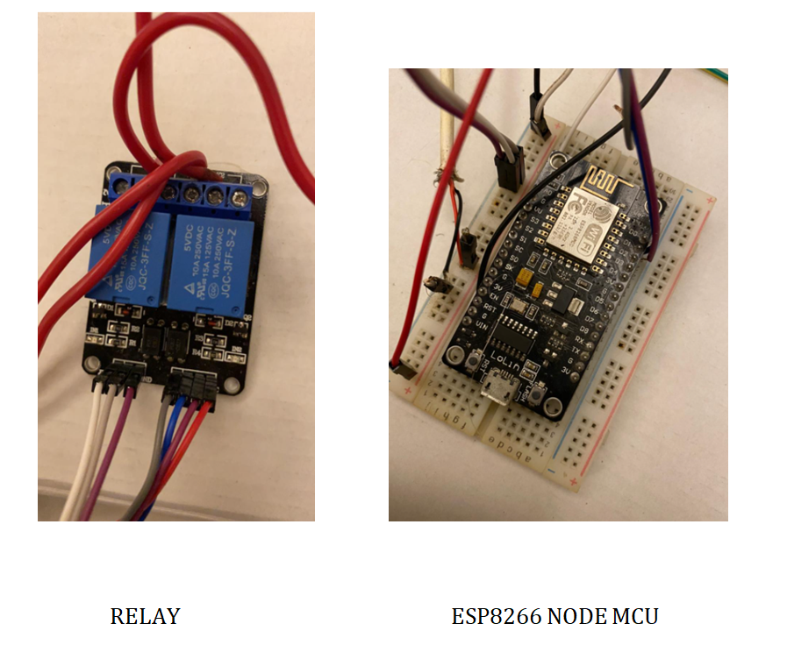
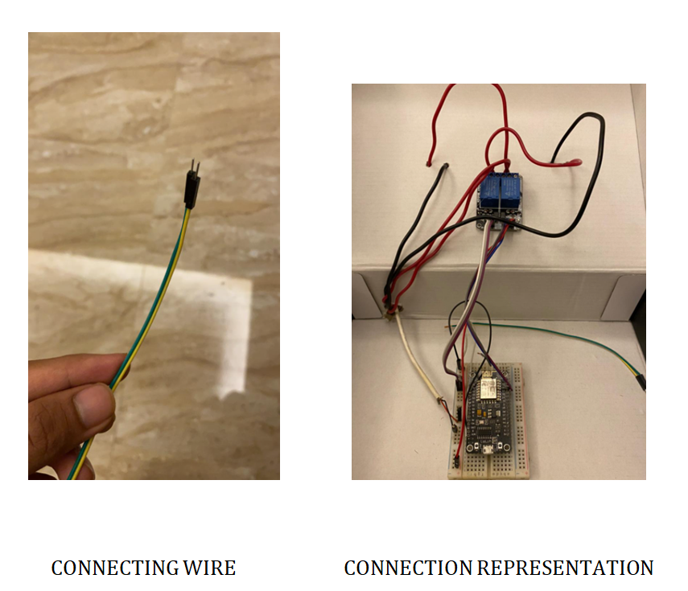
FEW SNIPPETS OF THE PROJECT COMPONENTS

Slide 14
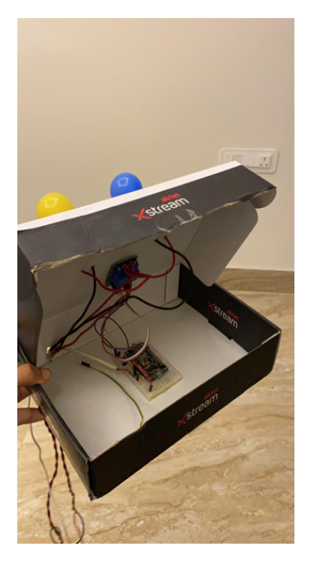
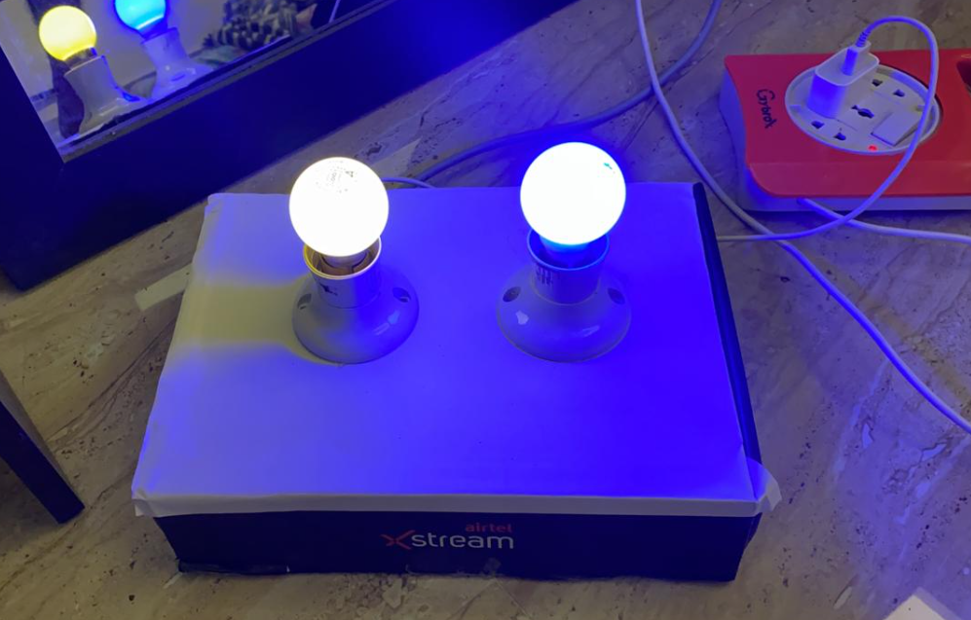
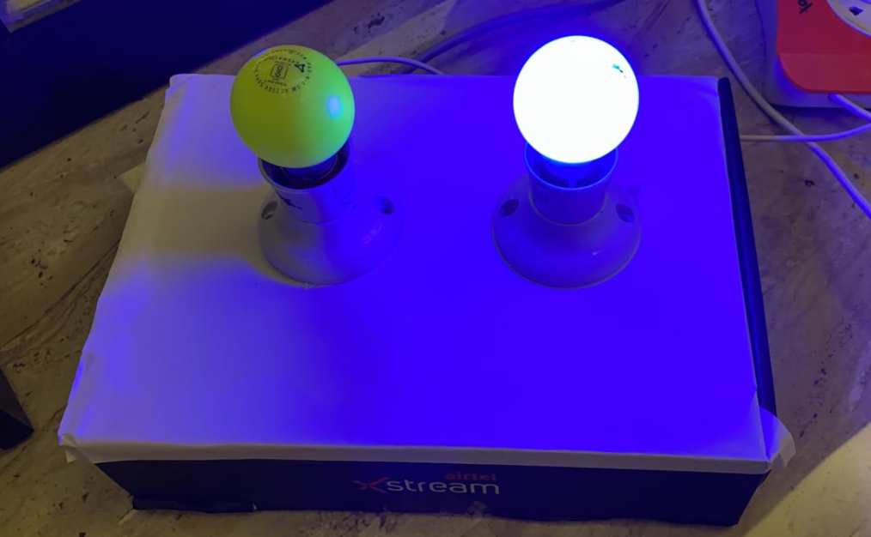

Slide 15
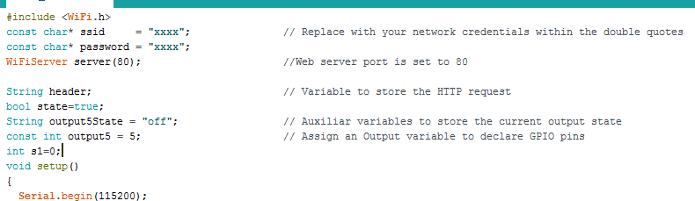
Arduino ide representation
We need an Integrated Development Environment and we will use Arduino IDE software. Arduino IDE is a cross-platform application.
The library ‘wifi.h’ contains all the Wi-Fi functions used in the code.

Slide 16
References
https://www.cisin.com/coffee-break/Enterprise/what-are-some-interesting-project-ideas-that-combine-machine-learning-with-iot.html
http://oaji.net/articles/2017/1992-1517569453.pdf
https://www.irjet.net/archives/V2/i3/Irjet-v2i3317.pdf
https://www.researchgate.net/publication/321835804_Home_Automation_Using_IOT
https://www.upgrad.com/blog/iot-project-ideas-topics-for-beginners/
https://en.wikipedia.org/wiki/ESP8266
https://www.arduino.cc/en/ArduinoCertified/IntelGalileo

Slide 17
conclusion
IoT has a lot to offer to the different industrial and commercial sectors. With the aid of machine learning, it can provide break-through solutions for a smart energy management system, smart home security, smart retail shops, predictive equipment maintenance in industries, intelligent traffic routing, etc.

Slide 18


